Slide 1
STRENGTHENING CYBER DEFENSES IN ACADEMIA: A CASE STUDY OF CYBERSECURITY CHALLENGES AND STRATEGIES IN THE APPLIED COMPUTER SCIENCE DEPARTMENT AT THE UNIVERSITY OF WINNIPEG
RESEARCH PROJECT
PRESENTED BY VI LE, SUPERVISED BY DR. VICTOR BALOGUN

Slide 2

ABSTRACT
The Applied Computer Science Department at the University of Winnipeg is grappling with heightened cybersecurity threats, an issue that is increasingly prevalent in the open and interconnected realm of higher education. This research presents an investigation into current cybersecurity protocols, highlighting a 44% surge in attacks since 2022, the exploitation of social trust via phishing, and a critical shortage of cybersecurity expertise. Interviews with the university community reveal awareness but also a concerning gap in effective cybersecurity management and policy execution, exacerbated by the BYOD trend and rising IoT use. The study advises bolstering defenses through targeted employee training and a holistic cultural shift towards prioritized cybersecurity, supported by case studies that reveal the severe consequences of breaches in other universities. The urgency for improved security measures is emphasized, with a recommendation for more inclusive future research to better understand and respond to these evolving cyber challenges
1

Slide 3
BACKGROUND
“44% increase in cyberattack since 2022” -Checkpoint Blog
2200 cyberattacks every day according to research in 2017
28778 new vulnerabilities was discovered in 2023, an increase of more than 3000 compared to 2022 according to CVE
A recent cyberattack at the University of Winnipeg occurred on March 24, 2024
2

Slide 4
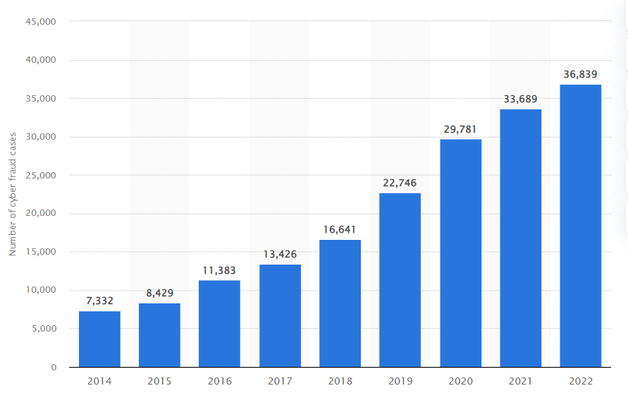
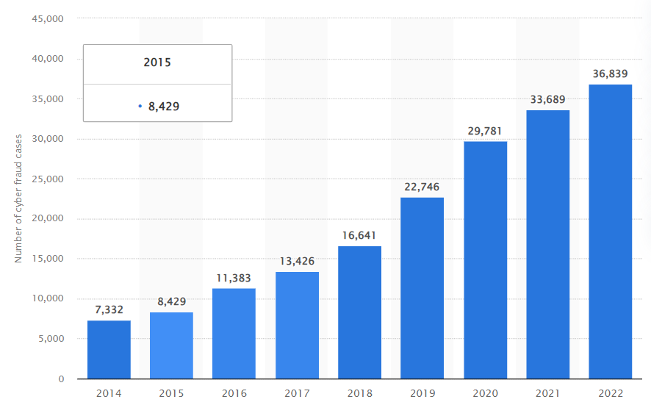
Number of police-reported instances of internet fraud in Canada from 2014 to 2022
3

Slide 5
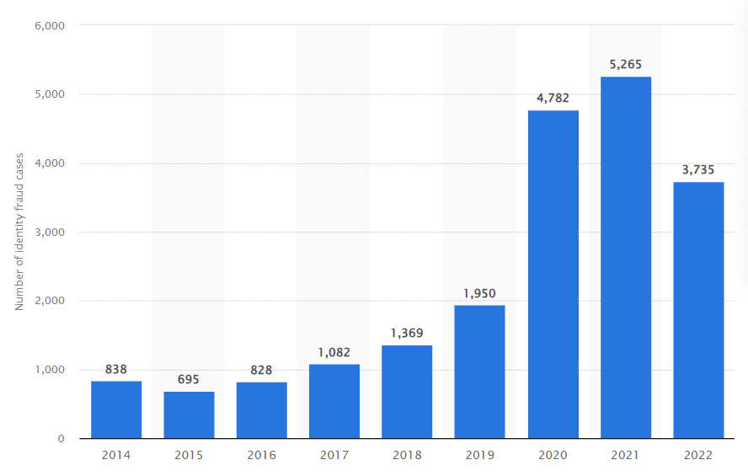
Number of police-reported instances of online identity fraud in Canada from 2014 to 2022
4

Slide 6
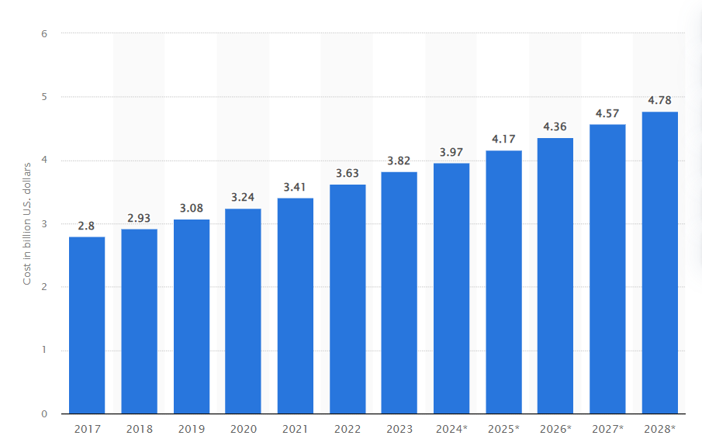
Estimated annual cost of cybercrime in Canada from 2017 to 2028
5

Slide 7

OBJECTIVES
1 Investigate past cyber attacks within ACS department.
2 Analyze attack methods, attack surfaces, and damage caused due to those past attacks.
3 Review current systems, critical assets, and architectural design of ACS department
4 Evaluate current protocols, and security policies of ACS department
5 Evaluate the effectiveness of current control mechanisms, defensive measures implemented in ACS department’s system.
6 Conduct risk analysis and propose strategies to mitigate those risks.
7 Design an incident response plan for ACS department.
8 Design penetration testing plan for ACS department
6

Slide 8
SCOPE OF RESERACH
ACS Physical Security
ACS
TECHNOLOGY SOLUTION CENTER
Systems and Networks
Policies and Guidelines
Human Factor
7

Slide 9





CHALLENGES UNIQUE TO ACADEMIC SETTING
1.
Limited Academic Literatures about Subject
2.
Culture of Openess
3.
Decentralized Systems
4.
Bring Your Own Device Policy
5.
IoT Adoption
8

Slide 10
METHOLOGY
1.
Conduct Interviews
2.
Do Interview Analysis
3.
Create High-level network diagram of ACS
4.
Conduct Threat Modeling
5.
Risk Evaluation
9

Slide 11

PARTICIPANTS
Students
Faculty member
Administrator/
Technician
A member of Information Security Managment
10

Slide 12

INTERVIEW QUESTION SETS
Students
Faculty member
Administrator/
Technician
A member of Information Security Managment
11

Slide 13
INTERVIEW PROCESS
Invite participant
Coordinate time and place for interview
Sign Consent form
Ask Permission for Audio Recording
Start Interview
12

Slide 14


INTERVIEW ANALYSIS
Quantitative Data
Qualitative Data
13

Slide 15
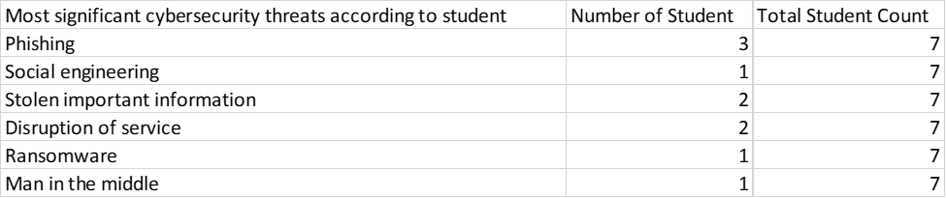
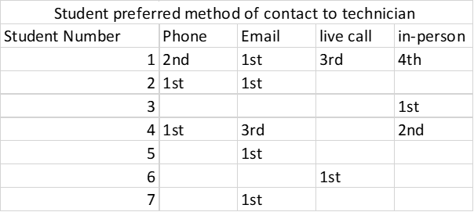
SOME QUANTITATIVE DATA
14

Slide 16
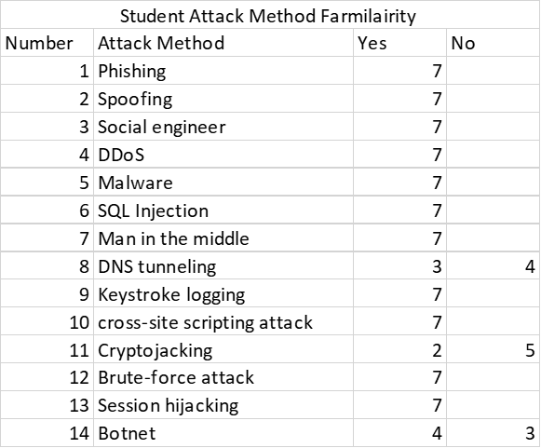
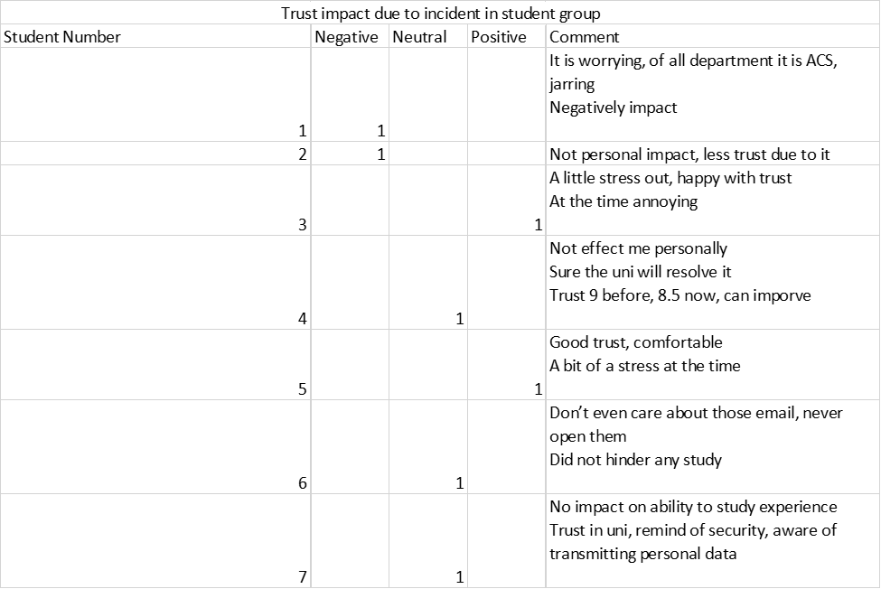
SOME QUANTITATIVE DATA
15

Slide 17

SOME QUALITATIVE DATA
Student’s cybersecurity incident in 2021, multiple students were affected
“In the middle of class, received a security email about some data breach and they needed to secure the student account. The email asked to verify and make sure to follow instructions”
The student was not so mindful, windows opened on the side, clicked link that opened a page that was “very professional looking”
The sender has legitimate domain name as webmail.uwinnipeg.ca
The student logged in and gave out their password then got logged out of Web Advisor, Nexus and University email.
“Got sign out from my service and The U of W student email got used for further phishing attacks. I only know of it because my friend texted me and asked yo is this you?”
The Student’s email was compromised and they used personal email to reach out to ACS department
15 minutes response time and help personnel did something on ACS end
Asked to log in with a new password
The entire thing was done in 30 to 40 minutes, resetting password took 30 minutes
50 minutes total to recover from the incident
16

Slide 18
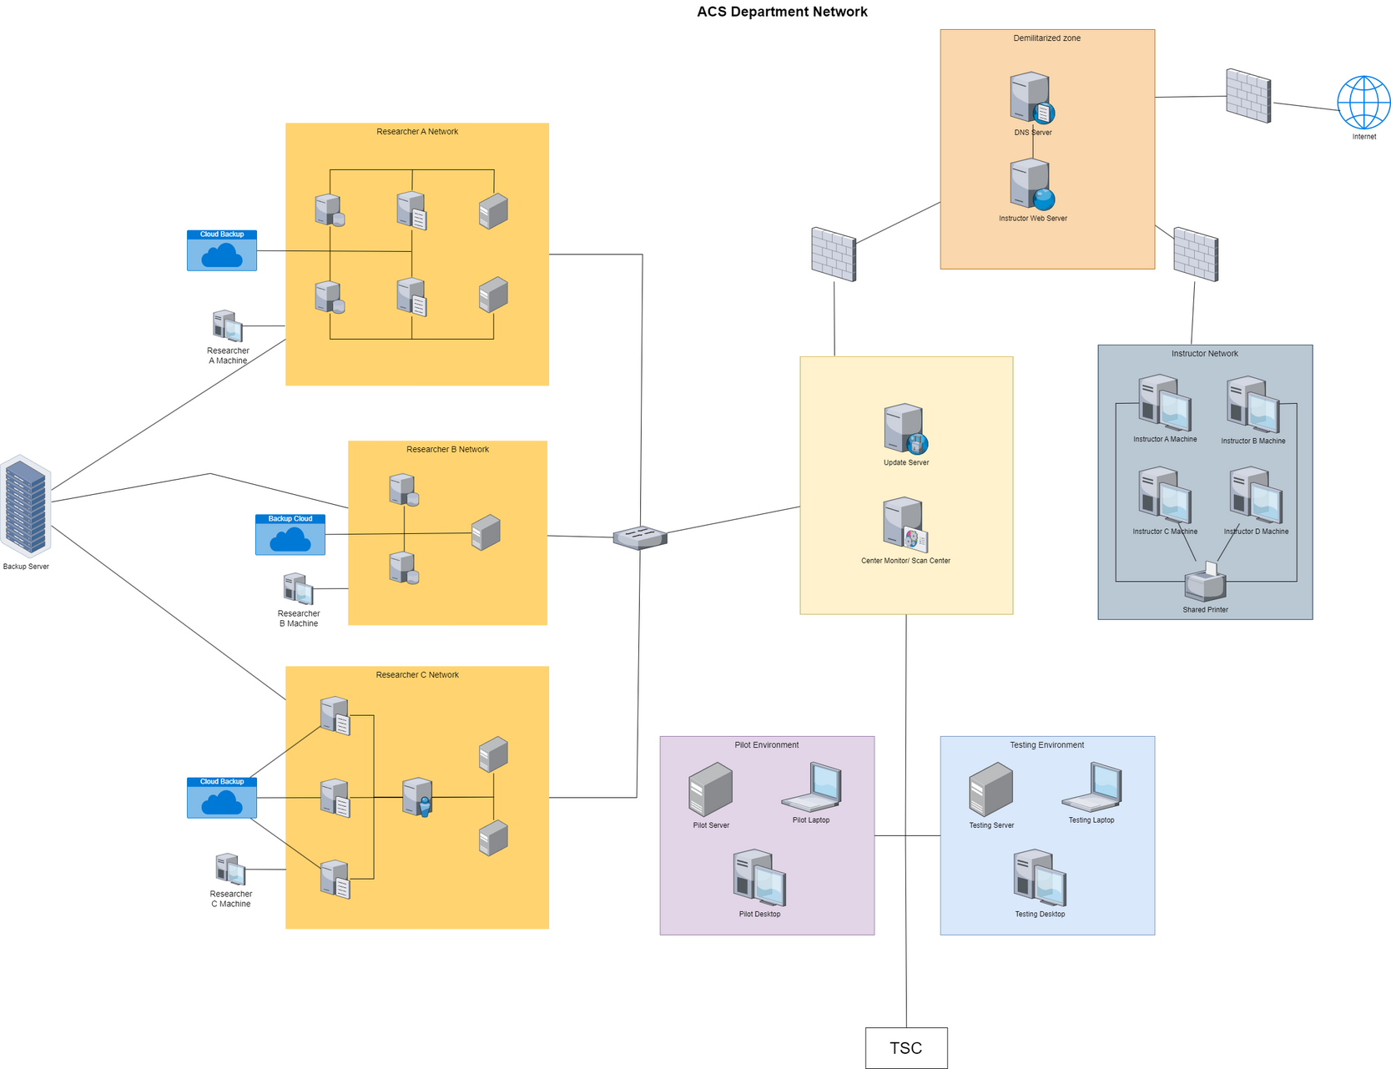
HIGH LEVEL NETWORK DIAGRAM
17

Slide 19
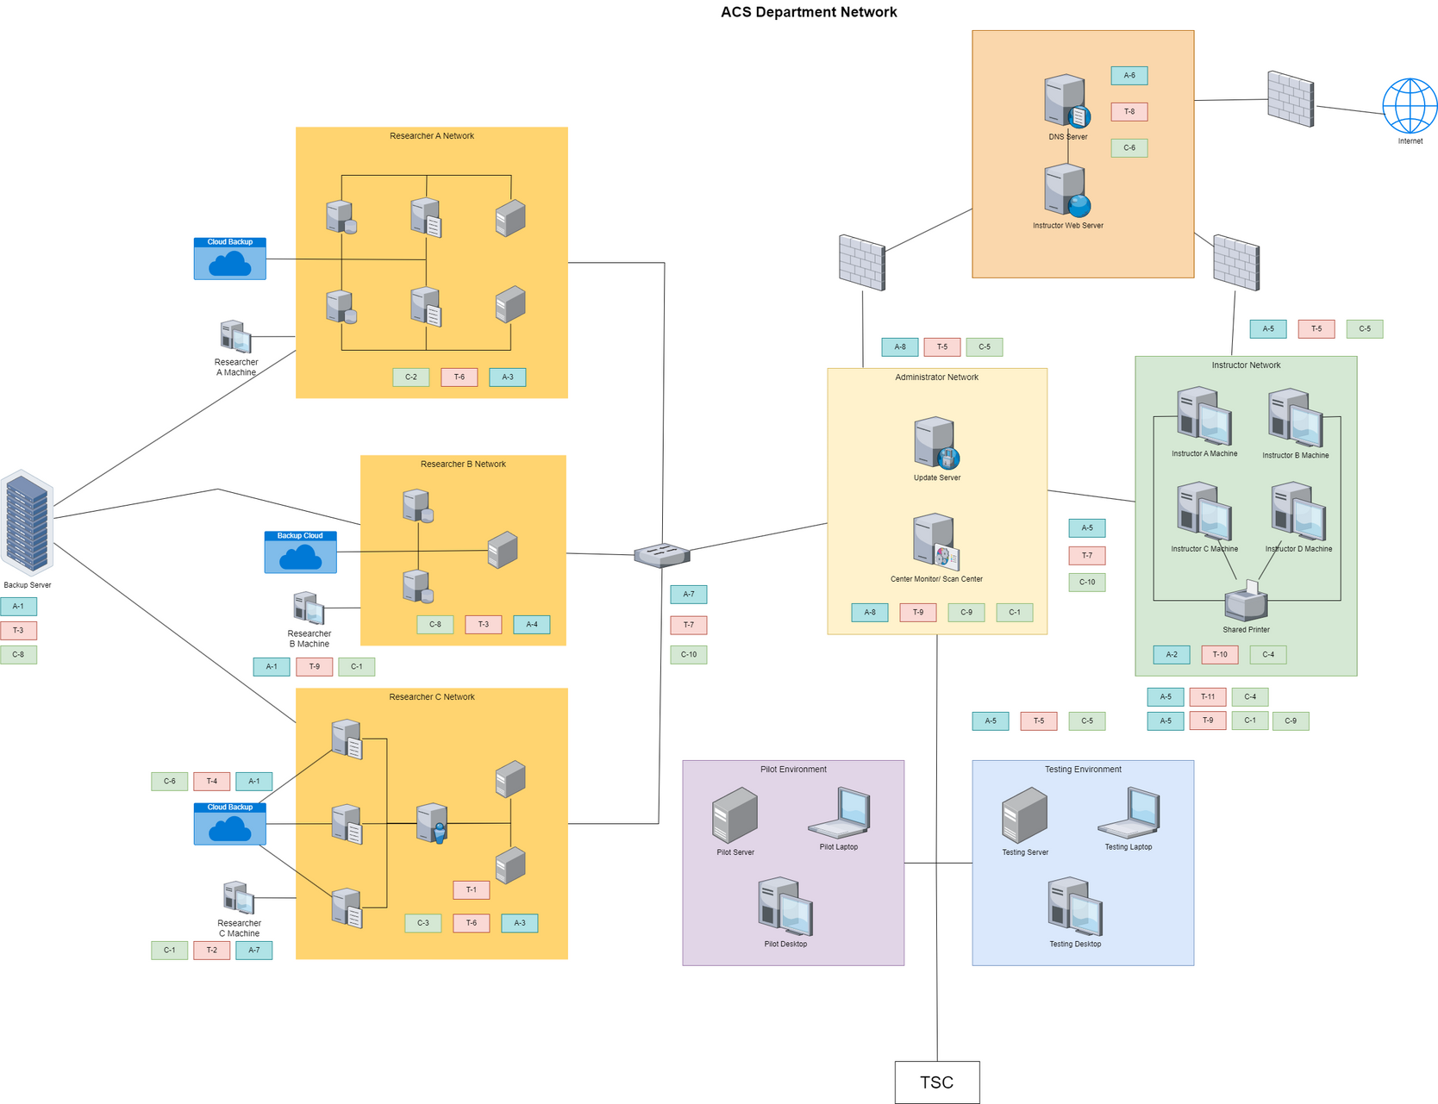
THREAT MODEL DIAGRAM
18

Slide 20
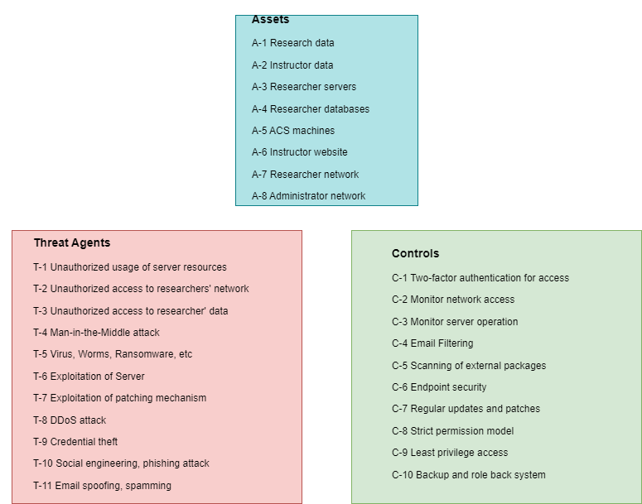
THREAT MODEL DIAGRAM
19

Slide 21
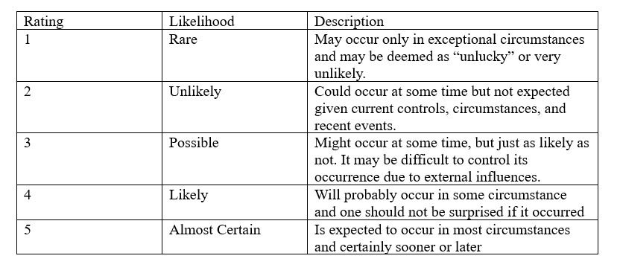
THREAT EVALUATION
LIKELIHOOD TABLE
20

Slide 22
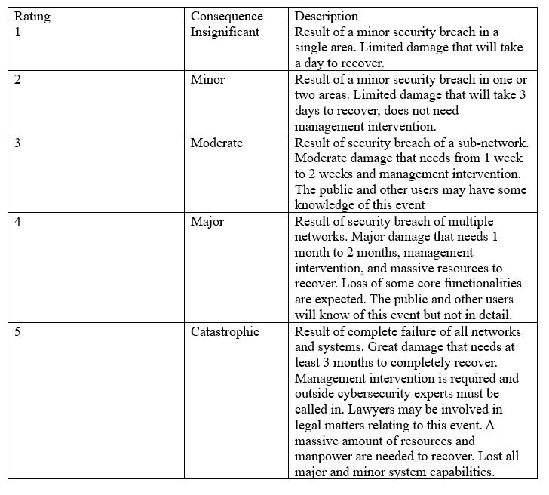
THREAT EVALUATION
CONSEQUENCES TABLE
21

Slide 23
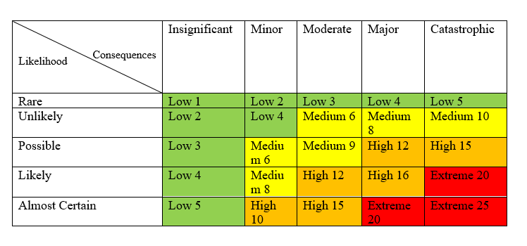
THREAT EVALUATION
RISK MATRIX
23

Slide 24
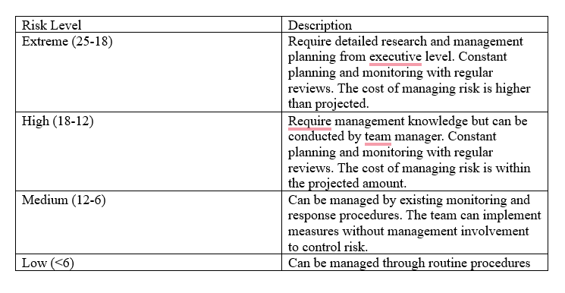
THREAT EVALUATION
RISK LEVEL TABLE
24

Slide 25
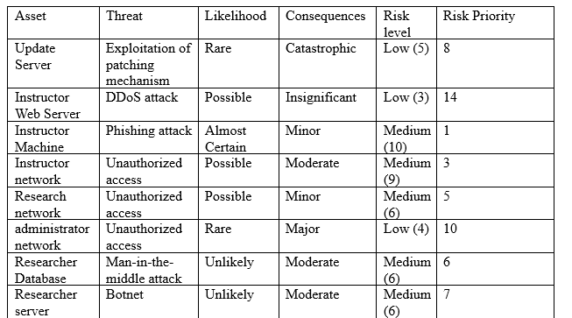
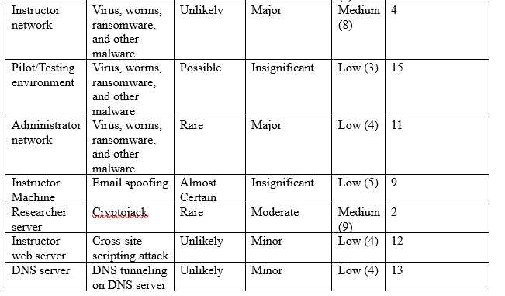
THREAT EVALUATION
RISK REGISTRY
25

Slide 26




IDENTIFIED VULNERABILITIES AND RISKS
ADVANDED PERSISTANT THREAT
ZERO-DAY VUNERBILITIES
PHYSICAL SECURITY
RESOURCE CONSTRAINT
25

Slide 27




IDENTIFIED VULNERABILITIES AND RISKS
INSIDER THREAT
OUTSIDE THREAT
FILELESS MALWARE
PHISHING ATTACK
26

Slide 28




IDENTIFIED VULNERABILITIES AND RISKS
POLICIES
UPDATE PROCESS
ACCESS AND PRIVILEGE CONTROL
COMMUNICATION
27

Slide 29







RECOMMENDATIONS
MOVE SHARED PRINTER
FINGER-PRINT LOCKS
HIRE MORE PERSONNEL
NO EDUROAM
LIMITED INTERNET
VIRTUAL MACHINE
PHISHING AWARENESS
28

Slide 30
RECOMMENDATIONS
PROPOSED SECURITY POLICY
No device connected to the ACS network can connect to Eduroam wifi network
Researcher’s servers and system cannot directly connect to the Internet
All external package such as email attachments, download must first be open in virtual machine before opening in user machine
29

Slide 31
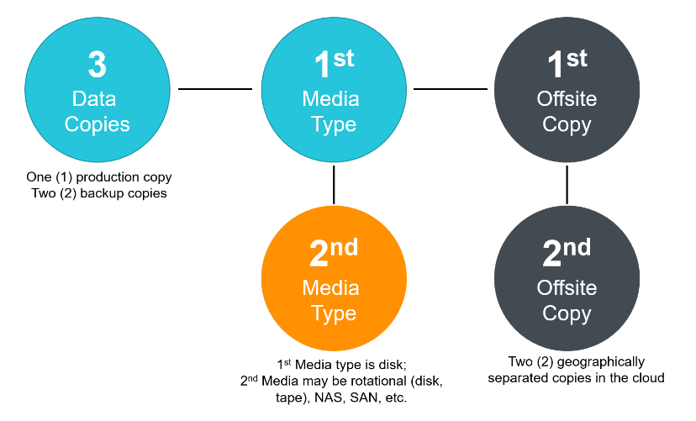
RECOMMENDATIONS
3-2-2 BACKUP SYSTEM
31

Slide 32
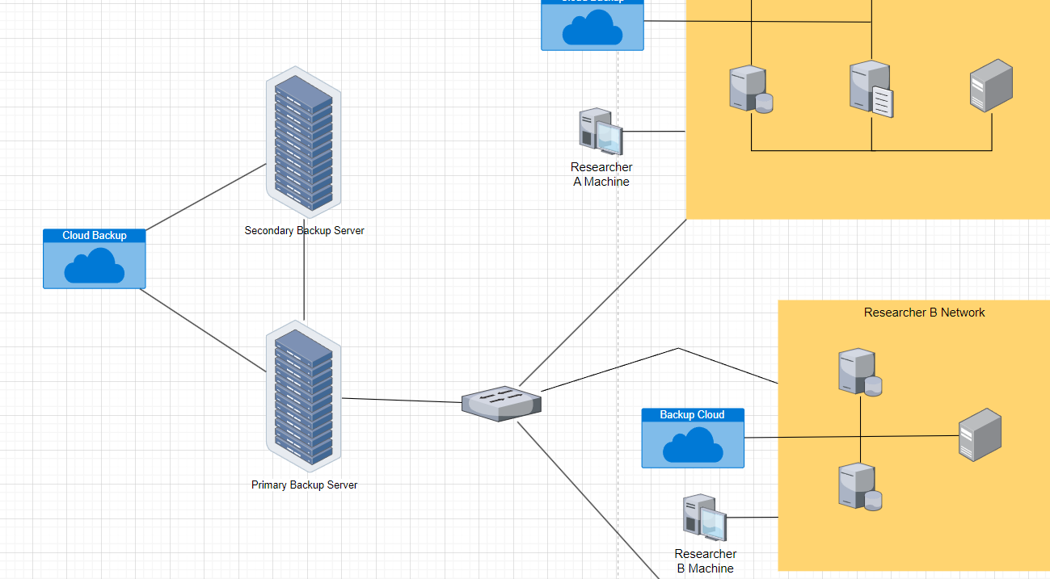
CHANGED HIGH LEVEL NETWORK DIAGRAM
30

Slide 33
RECOMMENDATIONS
PROPOSED INCIDENT RESPONSE PLAN
1.
2.
3.
Inform the department chair and TSC cybersecurity team about the incident
Compile as much relevant information as possible while waiting for a response from the Technology Solution Center cybersecurity team
Limit spread of damage, if multiple systems compromised then isolate affected network
32

Slide 34
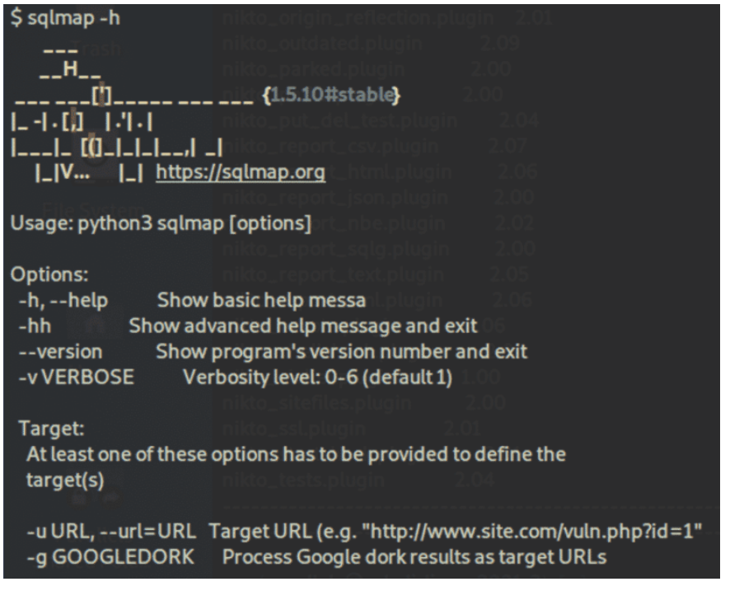

RECOMMENDATIONS
PENETRATION TESTING TOOL
33

Slide 35
RECOMMENDATIONS
PENETRATION TESTING PLAN
PHASE 1
Test pilot SQLmap on a dummy server in a testing environment
Implementing SQLmap in a limited capacity to a researcher’s network for 3 months, monitor testing and evaluate effectinvess
PHASE 2
PHASE 3
Expand penetration testing to all researchers’ networks and automate the process
34

Slide 36
CITATION
Statista. (2024, March 18). Canada’s number of internet fraud cases from 2014 to 2023. https://www.statista.com/statistics/1456731/internet-fraud-cases-canada/
Statista. (2024b, March 19). Canada’s number of identity fraud cases from 2014 to 2023. https://www.statista.com/statistics/1457331/identity-fraud-cases-canada/
Statista. (2024b, March 19). Canada’s predicted cost of Cybercrime from 2017 to 2028. https://www.statista.com/forecasts/1457244/canada-cybercrime-cost-annual
Jain , S. (2024, February 8). 160 cybersecurity statistics: Updated report 2024. Astra Security Blog. https://www.getastra.com/blog/security-audit/cyber-security-statistics/#:~:text=Cybersecurity%20statistics%20indicate%20that%20there,cost%20%248%20trillion%20by%202023.
Security Magazine. (2020, May 24). Hackers attack every 39 seconds. Security Magazine RSS. https://www.securitymagazine.com/articles/87787-hackers-attack-every-39-seconds
Check Point Blog. (2022, August 16). Check point research: Education sector experiencing more than double monthly attacks, compared to other industries. https://blog.checkpoint.com/2022/08/09/check-point-research-education-sector-experiencing-more-than-double-monthly-attacks-compared-to-other-industries/
The University of Winnipeg. (2024, March 25). Cyber attack and service outage. https://www.uwinnipeg.ca/updates/index.html?eid=aa32babed1cb2cfb62dd985e81fd67e1
35

Slide 37

THANK YOU FOR LISTENING
ANY QUESTIONS? ASK AWAY
PRESENTED BY VI LE, SUPERVISED BY DR. VICTOR BALOGUN

